Slide 1

DÓZSA CSÁRDA
Pálosi András
Pongrácz Gábor
Farkas Bence

Slide 2

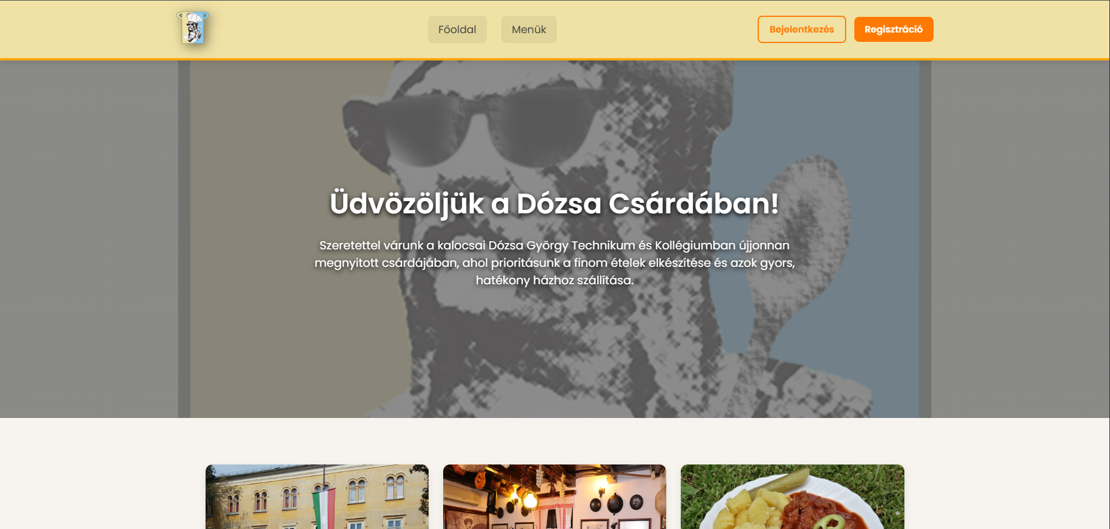
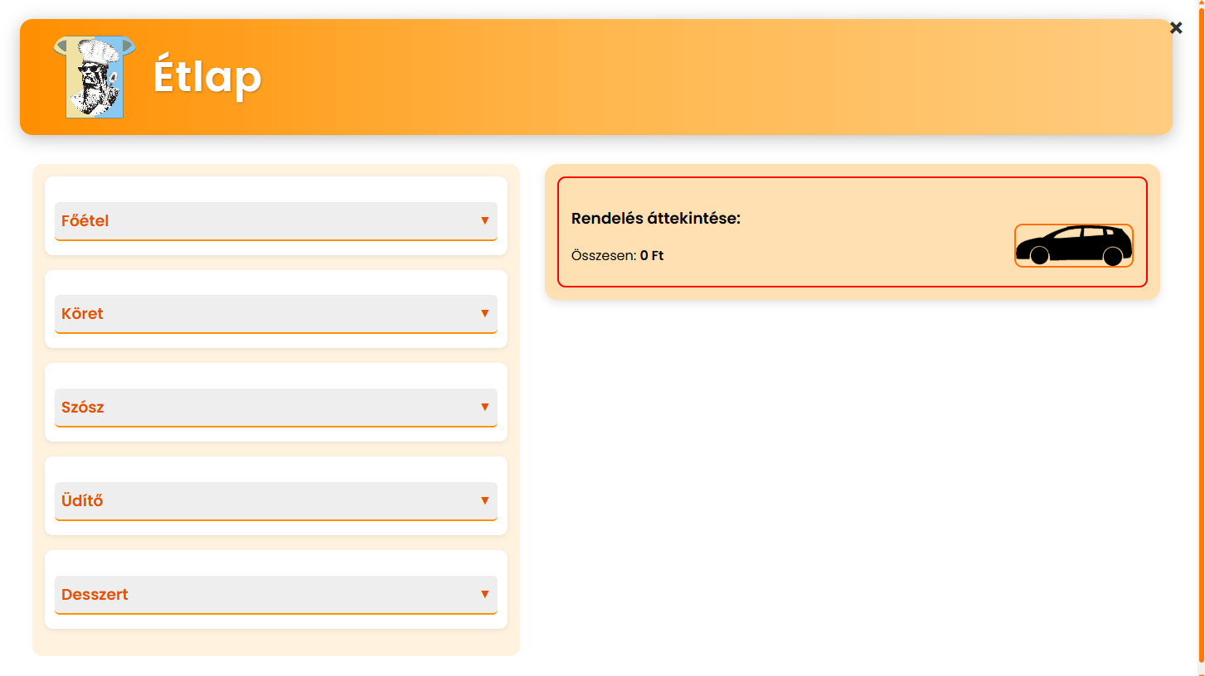
Project introduction
The „Dózsa Csárda” project’s goal to accomplish an easy and user friendly food delivery system.
You can create unique orders from the 5 categories on the website!
Orders are only accessible upon registration on the website.

Slide 3
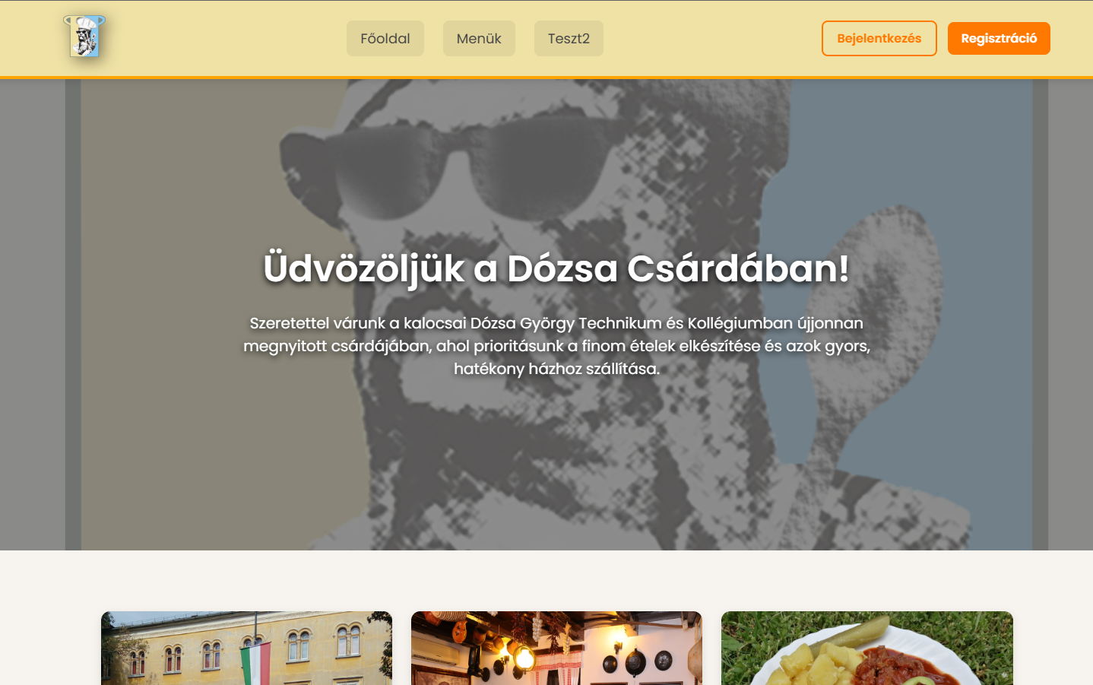
Projekt Bemutatása
•A Dózsa Csárda projekt célja hogy egy gyors és felhasználóbarát oldalon az élelmiszer rendelést tegye sokkal egyszerűbbé.
Az önálló rendeléseket 5 kategóriából lehet összeállítani, mely biztosítja, hogy saját stílus szerint lehessen ebédelni. :)
Az oldal csakis akkor használható, ha regisztrálnak az oldalra, melyhez az oldalon sok segítséget nyújtunk. Egyszerű és érthető segítségeket és hibaüzeneteket kínálunk.

Slide 4

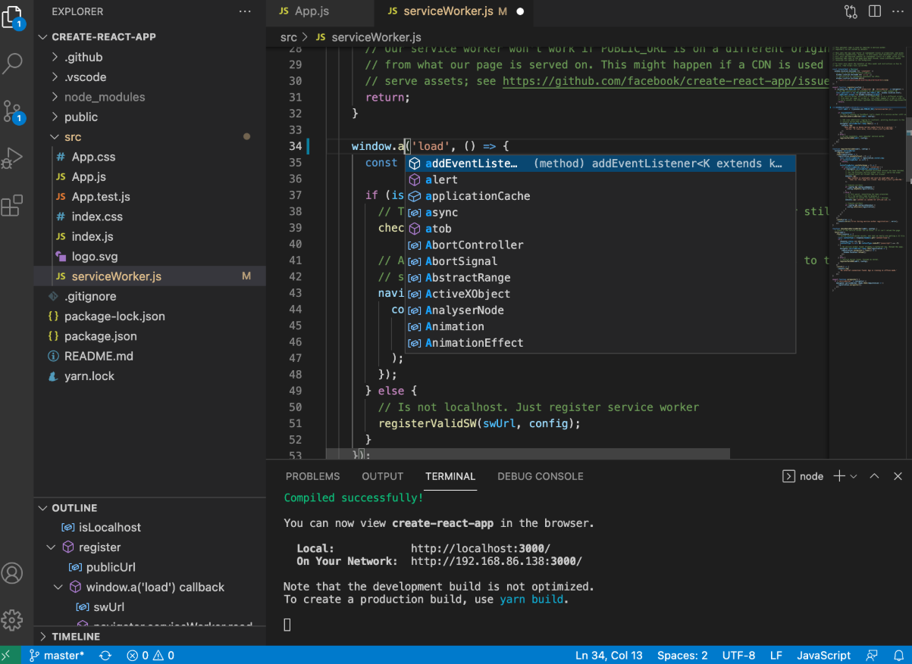
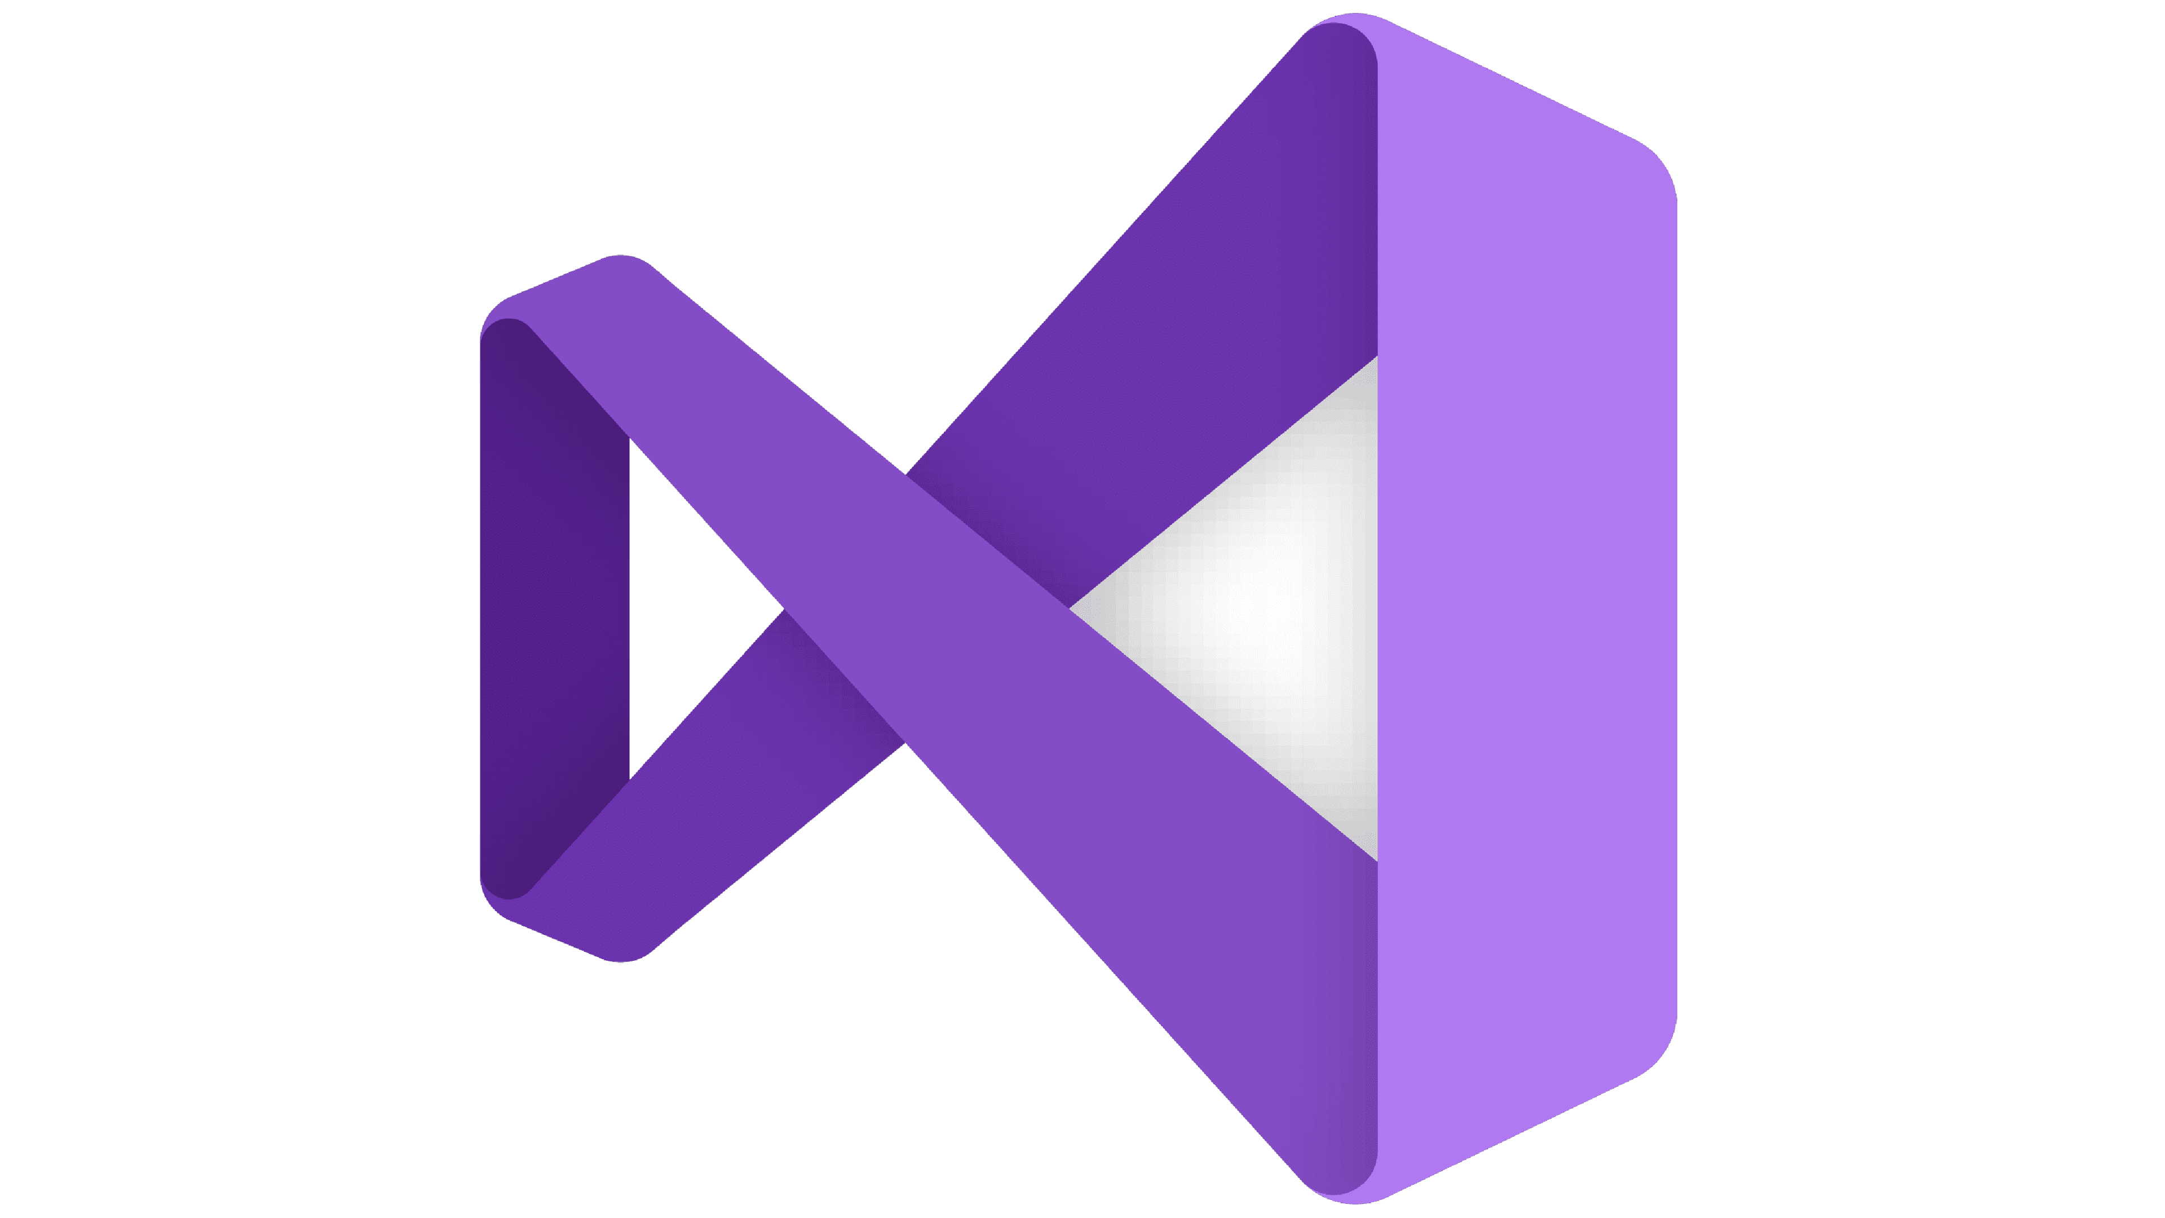
Development environment
Visual Studio Code(VSC): An Integrated Development Environment, in which the server and the frontend (html, css, javascript) were created.
Visual Studio(VS): An IDE, which we used to create the administrative interface of WPF.

Slide 5
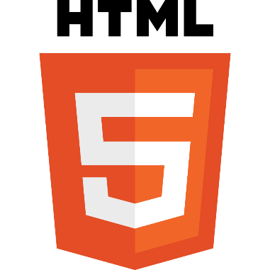
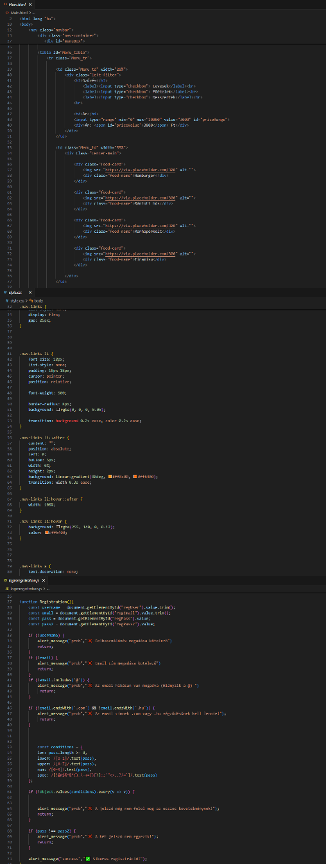


Development environment
HTML5: A web page creation language, which we used to create the framework of the website.
CSS3: A style managment language that we used to create the interface of the website.
JavaScript: A language used to make the website dynamic and manage It’s events.

Slide 6

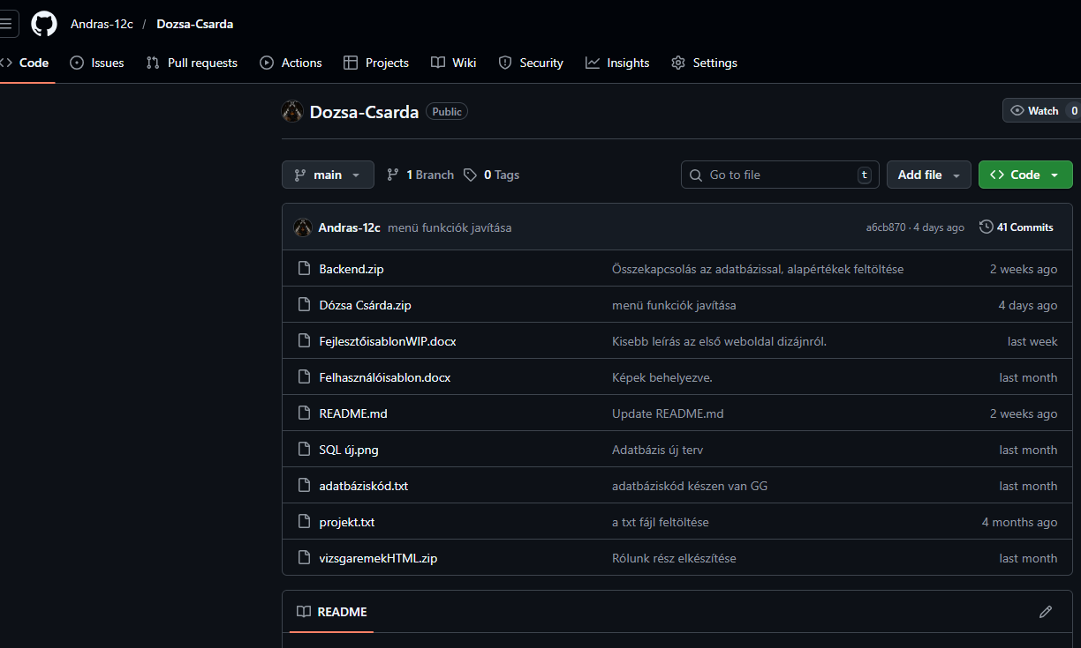

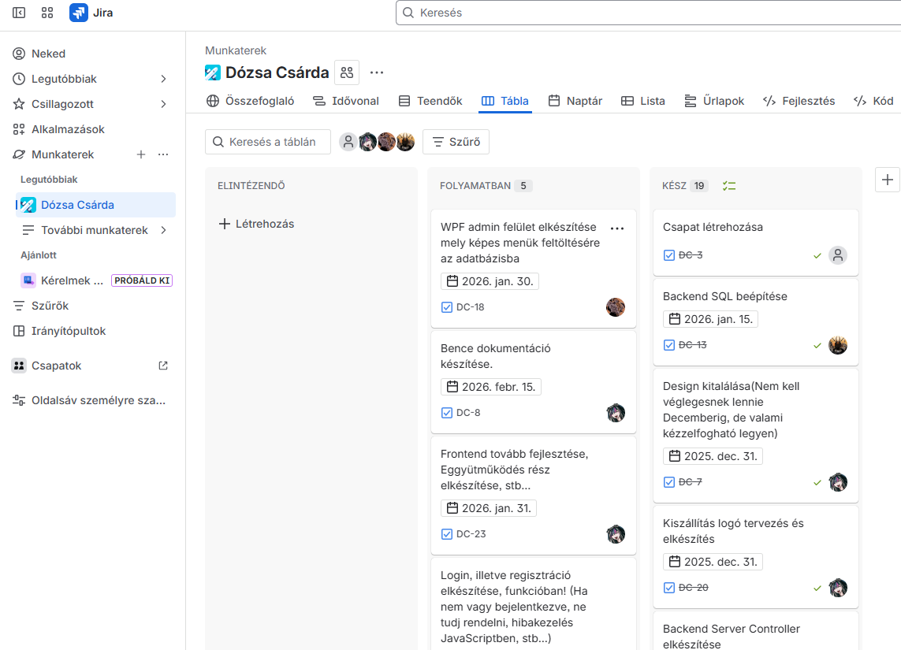
Group work environment
GitHub: Version managment web or desktrop application that functioned as a cloud for us.
Jira: Project managment website, where we made it possible to track individual subtasks of the project.

Slide 7
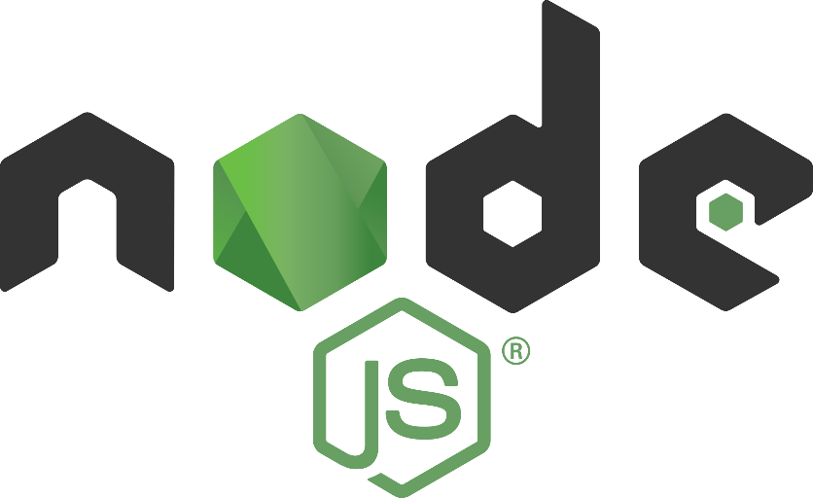
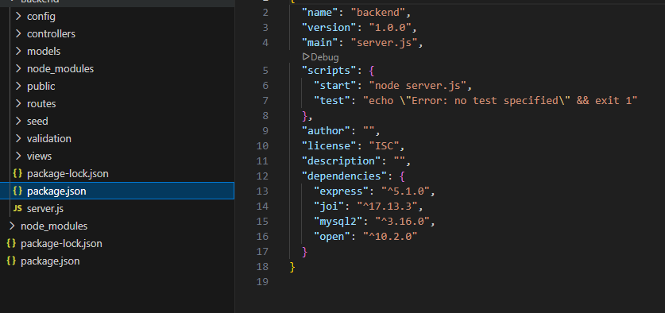

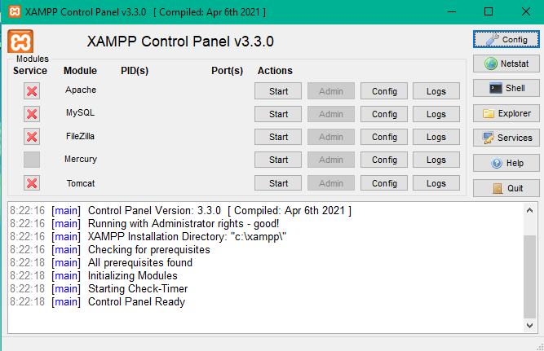
Package managers
Node.Js: The JavaScript package manager, which we used to download the modules required for the Backend Server. e.g.: Express, etc…
XAMPP: A platform-independent database package manager, in which we used the SQL(MariaDB) language and PHP My-Admin for visual display on the Apache server.

Slide 8
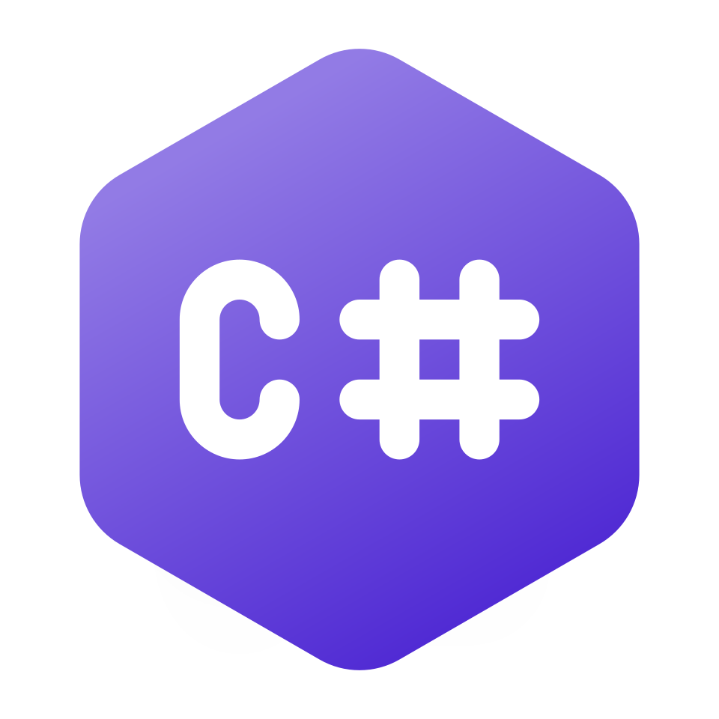
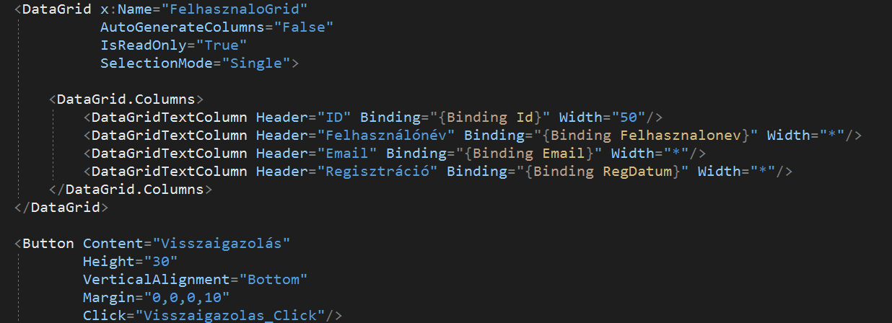

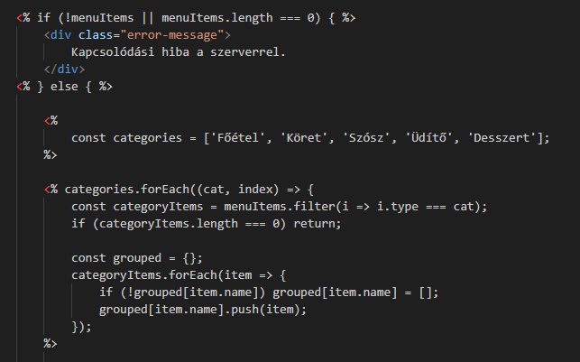


Programming languages
C#: Object-oriented programming language. We also used the WPF open source user interface framework to manage the database of our project.
EJS(Embedded JavaScript): This is a templating engine, for Node.js that allows to embed JavaScript code into the HTML.
Syntax: <%= %>

Slide 9
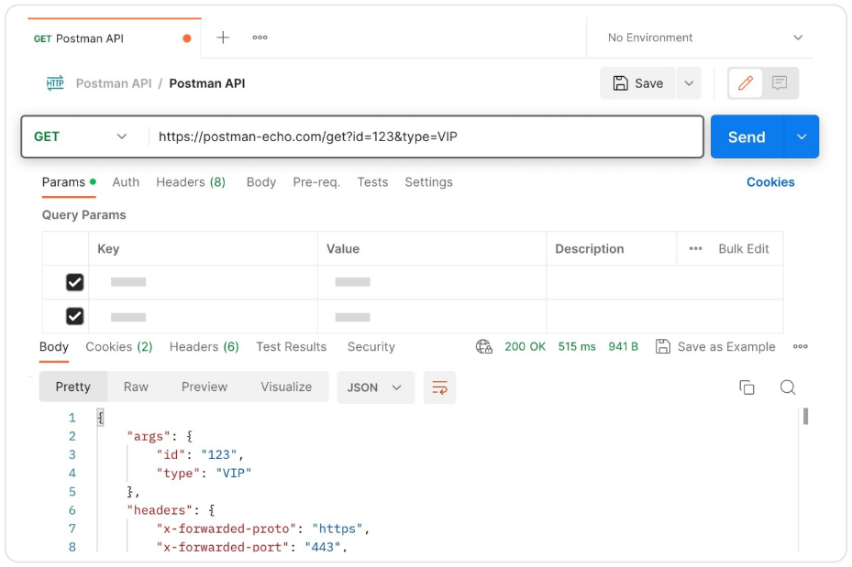

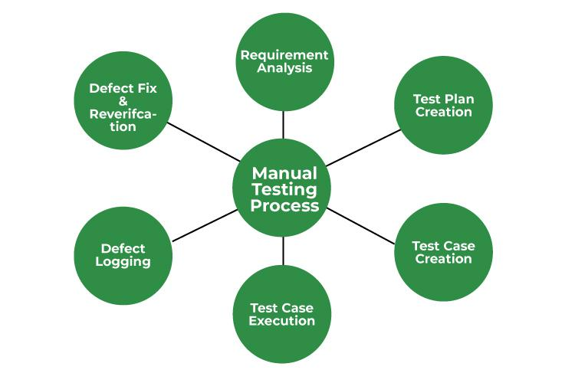
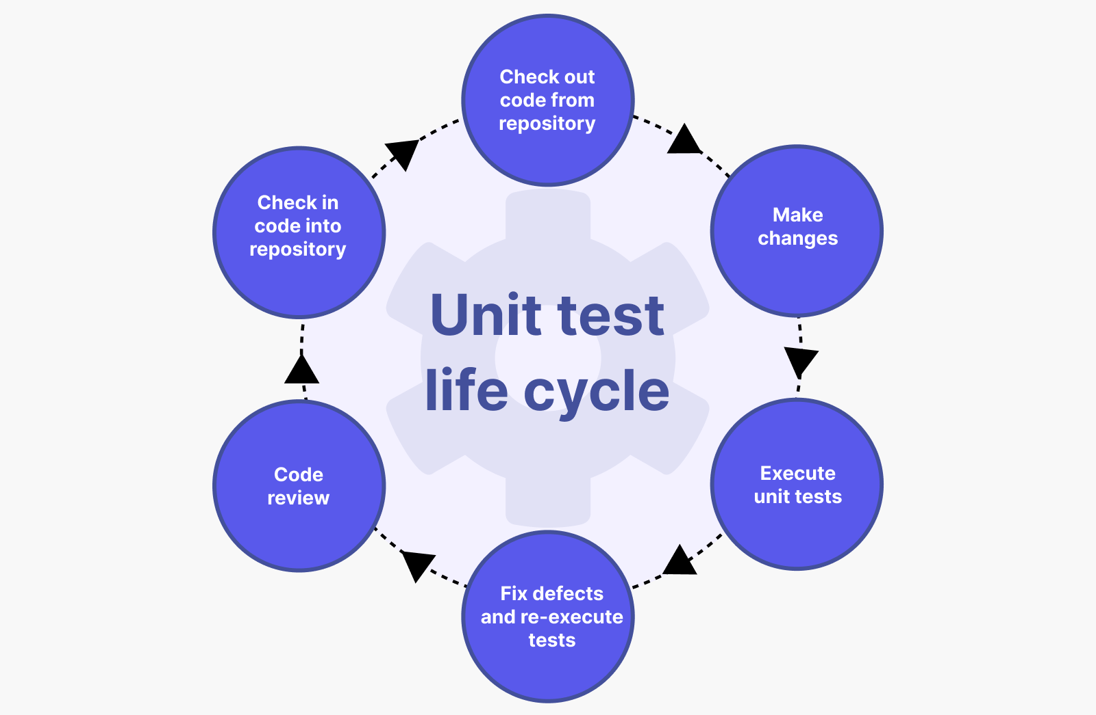
Testing tools
Postman: A desktop application that allowed us to test REST API endpoints based on CRUD operations.
Manual Testing: Without automated tools, they look for errors and deficiencies in the system by taking on the role of the end user.
Unit Testing: A unit test that checks a specific unit of the program (e.g., a function).

Slide 10
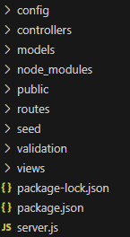
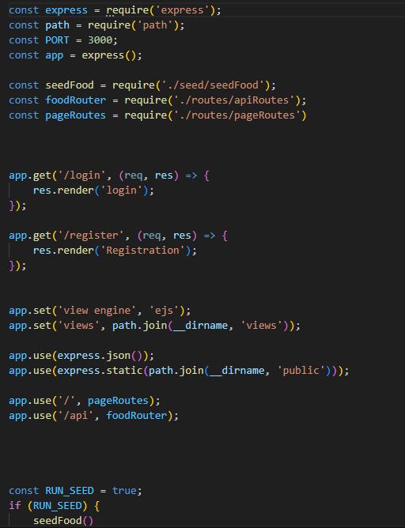
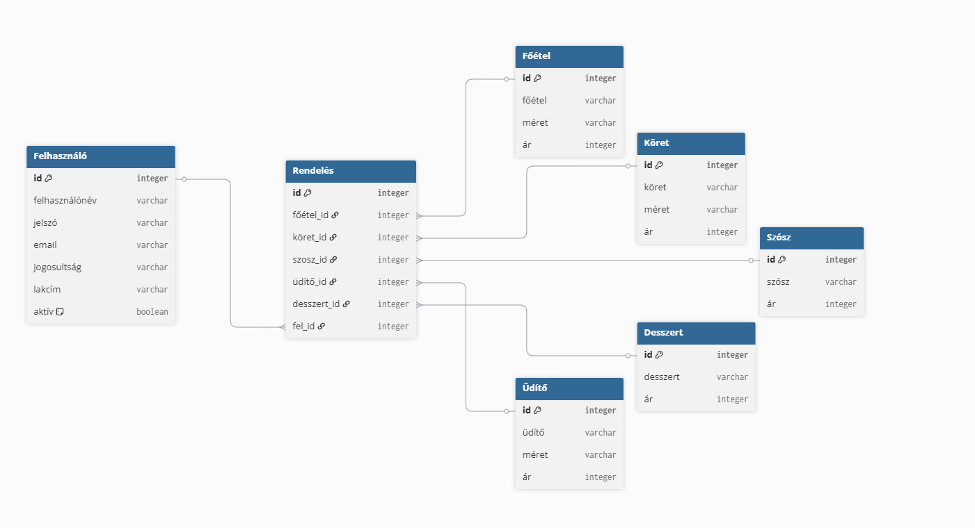




Stock text
Database: Contains 7 Table that identify the user, and all the food you can order.
Backend: The backend server is responsible for running the full REST APIs and handling CRUD operations

Slide 11
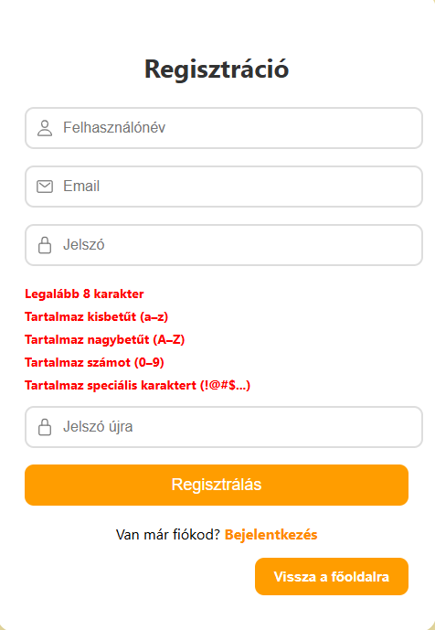
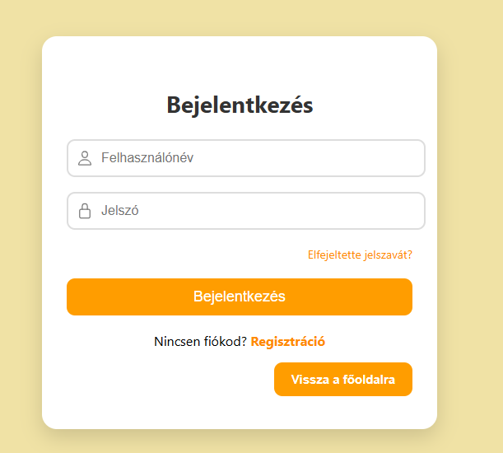
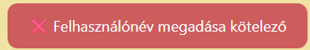

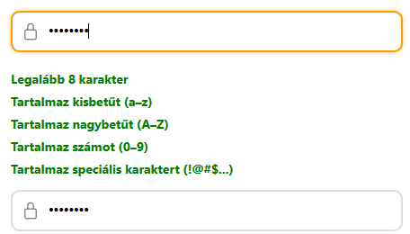
Registration/Sign Up
User Friendly:
Obvious Error messages:

